Slide 1
Modelling Honeybee Vision
Robert Chisholm
(in collaboration with Adam Petterson)

Slide 2

The Green Brain Project
Modelling a Honey Bee brain
Parallel Computing
Flying Robotic Platform
~1,000,000 Neurons
Advances from robotics - cognitive psychology
Understanding the decline in bee populations?
Notes:
artificial brain, great ai challenge
greenbrain->complete model bee brain, uav sense, think, act as bee
majority large scale, mice/verterbrate, 1m, 56m rat, 85bn, realistic
provide advances from robotics, cog psych and baseline for future research
May even help understand bee pop decline

Slide 3
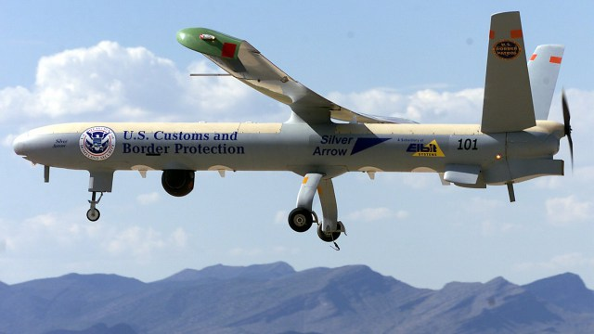
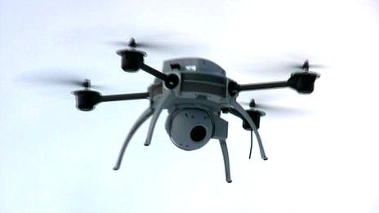
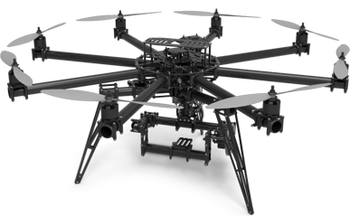
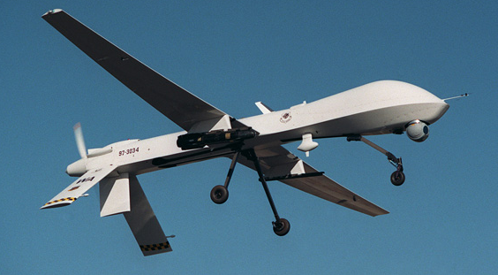
UAVs
Notes:
UAVs (unmanned aerial vehicles) are +used in dull, dirty, dangerous or otherwise expensive;
Nuclear Power Plants
Search & Rescue
Weather Forecasting
Wild-fire surveillance
Agriculture
Border patrols
Usage+ = robust adaptive algorithms that provide real-time performance
extending existing models, demo sophisticated visual navigation and cognitive functions on a uav

Slide 4
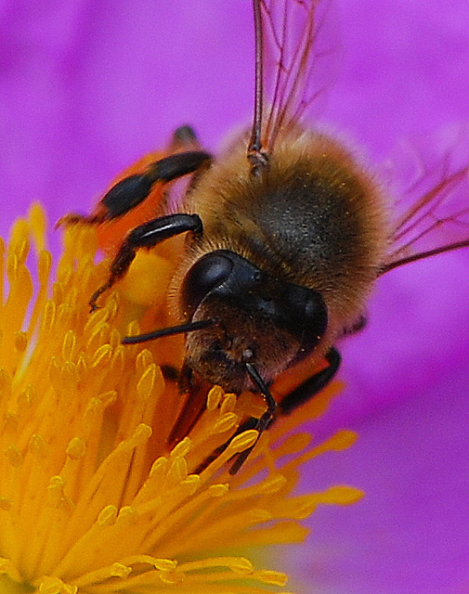
Honey Bee Vision
4500 Ommatidia per eye
Arranged in a hexagonal structure
280° field of view
Minimal stereoscopic vision
Head motion within camera image
Optic Flow
Notes:
Vision sys important
HD unrealistic, too much
correctly replicate; field of view, visible light wavelengths & resolution
quadro-copter will be mounted with dual
success = optic flow (apparent motion of objects in a visual scene caused by relative motions between the observer and scene)

Slide 5
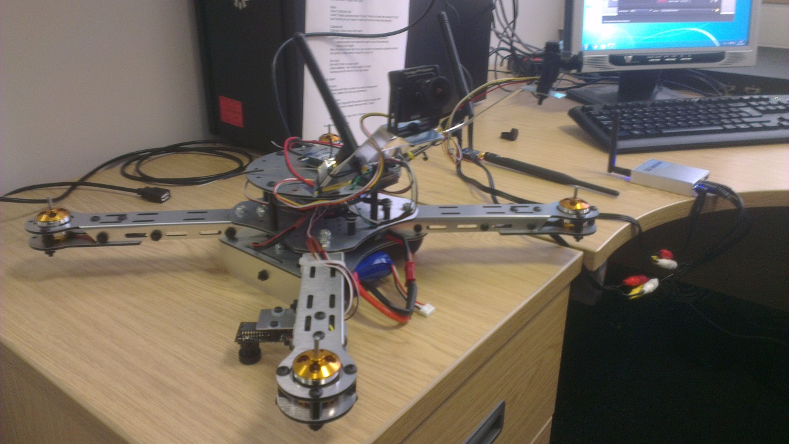
Work Distribution
Dual Camera Input
Angle Calibration
Filters
Hexagonal Subsampling
Head Motion
Optic Flow
Notes:
This project is very linear with most stages being slight or wholly dependent on previous stages, some of the steps such as the filters and sub-sampling can be developed separately however these are likely smaller steps with respect to the whole project. Short of one of us researching the next stage while the other develops the prior it has been hard to cleanly allocate the work. Currently this has worked with Adam focusing on handling the camera input (as he worked with similar libraries during his dissertation) whilst I research the necessities for calibrating so that we can maintain or recover the real world angles post-processing.
We expect there may be challenges in overcoming hardware restrictions (There have currently been issues with using 2 capture cards simultaneously), wireless interference and any rotors or parts of the quadro-copter that are in the field of view.

Slide 6
Existing Research
Honey Bees as a Model for Vision, Perception & Cognition, Mandyam V. Srinivasan [2010]
The Visual Acuity of the Honey Bee, Selig Hecht & Ernst Wolf [1929]
Color Receptions in the Bee Eye – Morphology & Spectral Sensitivity, R. Menzel & M. Blakers [1975]
Colour Distance Derived from a Receptor Model of Color Vision in the Honeybee, W. Backhaus & R. Menzel [1987]
Notes:
Review=Vision, Perception or Cognition fact sheet; 4500 ommatidia (pixels), 9 photo receptors, uv, blue and green, hexagonal arrangement, longer thinking time between closely related colours increases accuracy(believed to be improved signal-noise ratio over longer observation), able to gauge the true colour of an object whether it be in direct light or shade, a bee’s visual acuity means that humans are able to resolve an environment 170 times better than a bee can.
It also covered some less relevant details about memory such as bees ability to remember patterns and orientation, as opposed to complete snapshots (low density storage in the small brains?)
Ability to follow visual cues, count upto 4 landmarks and follow different routes ay different times of day to complete mazes given training.
The other papers we were directed to were much more biology heavy and a number of the statistics learned from their experiments have since been trumped by more recent research providing the different values in the prior review paper (a bees visual acuity measured as 100 worse than human as opposed to 170).
colour vision = Bee’s receptiveness to colour and the interference, thought dense receptors

Slide 7
Questions?
Git: https://github.com/Robadob/BeeVision (private, ask for access)
Progress Site: http://robadob.github.io/BeeVision/

